Slide 1
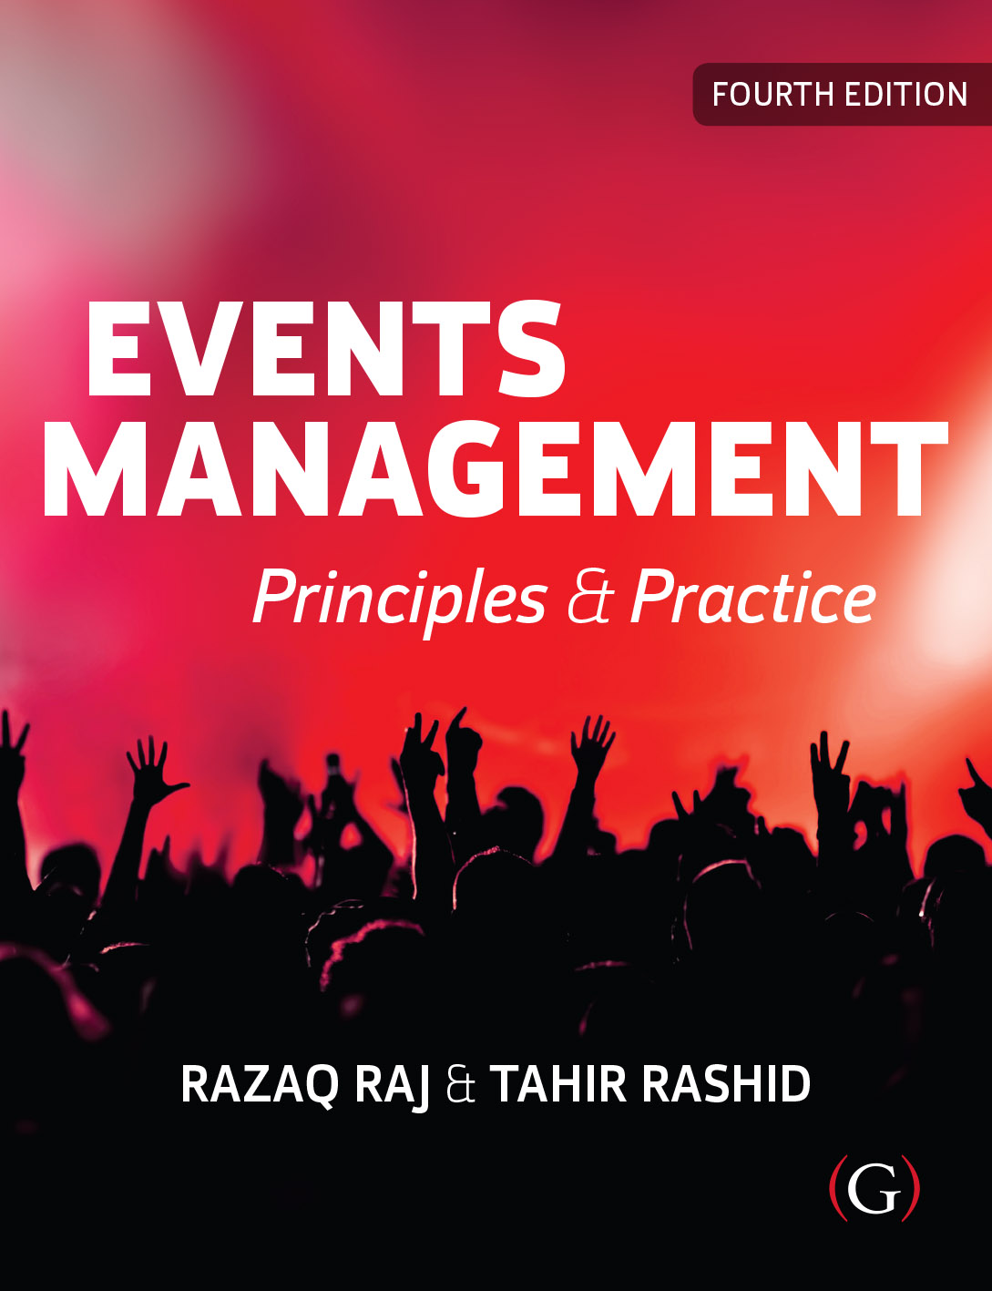
Events Management: Principles & Practice, 4th Edition
By Razaq Raj and Tahir Rashid

Slide 2
Chapter 4
Human Resource Management
To provide an overview of human resource management (HRM) for festivals and events.
Theories of HRM will be discussed
People are a key asset of any organisation
Management of people has to be at the heart of any strategic issue

Slide 3
Human Resource Management
HRM is about how people are employed, managed and developed in organsiations (Armstrong & Taylor 2020:3).
The planning process for HR needs to be carried out carefully in order to fulfil the needs of the different types of events

Slide 4
Types of Organisations
Flexible Organisations
  Functional Flexibility
  Numerical Flexibility

Slide 5
The goals of HRM are to:
Support the organisation in achieving its objectives by developing and implementing HR strategies which are integrated with the Event strategy
Contribute to the development of a high-performance culture;
Ensure that the organsiation has a talented, skilled and engaged people it needs;
Maintain a positive employment relationship between management and employees;
Provide for a satisfactory employee experience;
Further the well being of employees as major stakeholders
Armstrong and Taylor (2020)

Slide 6
HR Planning Process
Human Resource Strategy
Policies and procedures
Recruitment
Legal Rights of employees
Training and Professional Development
Supervision and appraisals

Slide 7
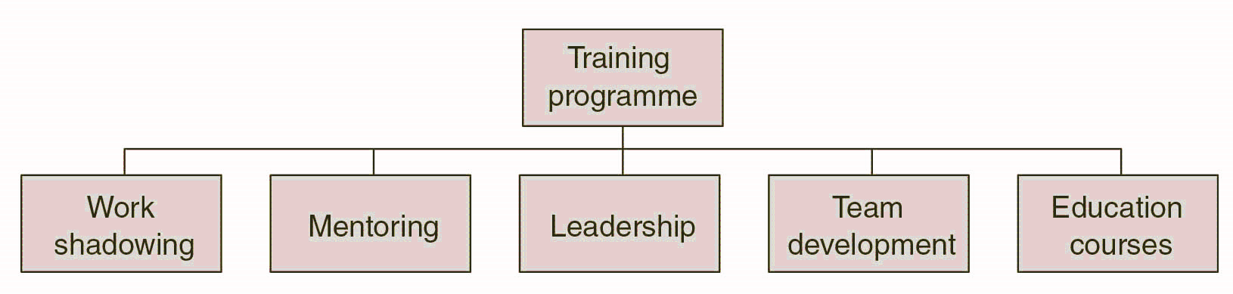
Training programme for Event Managers

Slide 8
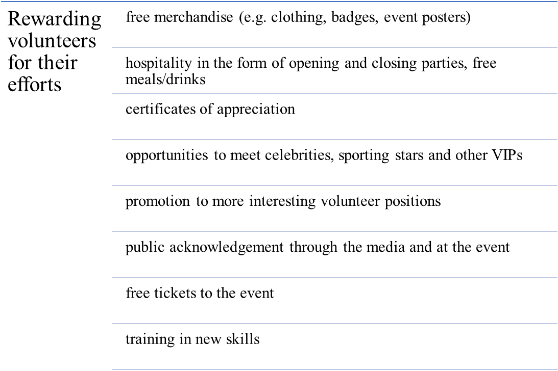
Rewarding volunteers for their efforts

Slide 9
Retaining Personnel in Event Organisations
Retention of staff is a fundamental issue
High turnover of staff places specific demands on event managers
Termination, outplacement and re-enlistment
Evaluation of Process

Slide 10
HRM Theories
Empowerment
Commitment
Diversity (See next slide)
Motivation
Expectancy Theory
The Social Aspect to Work

Slide 11
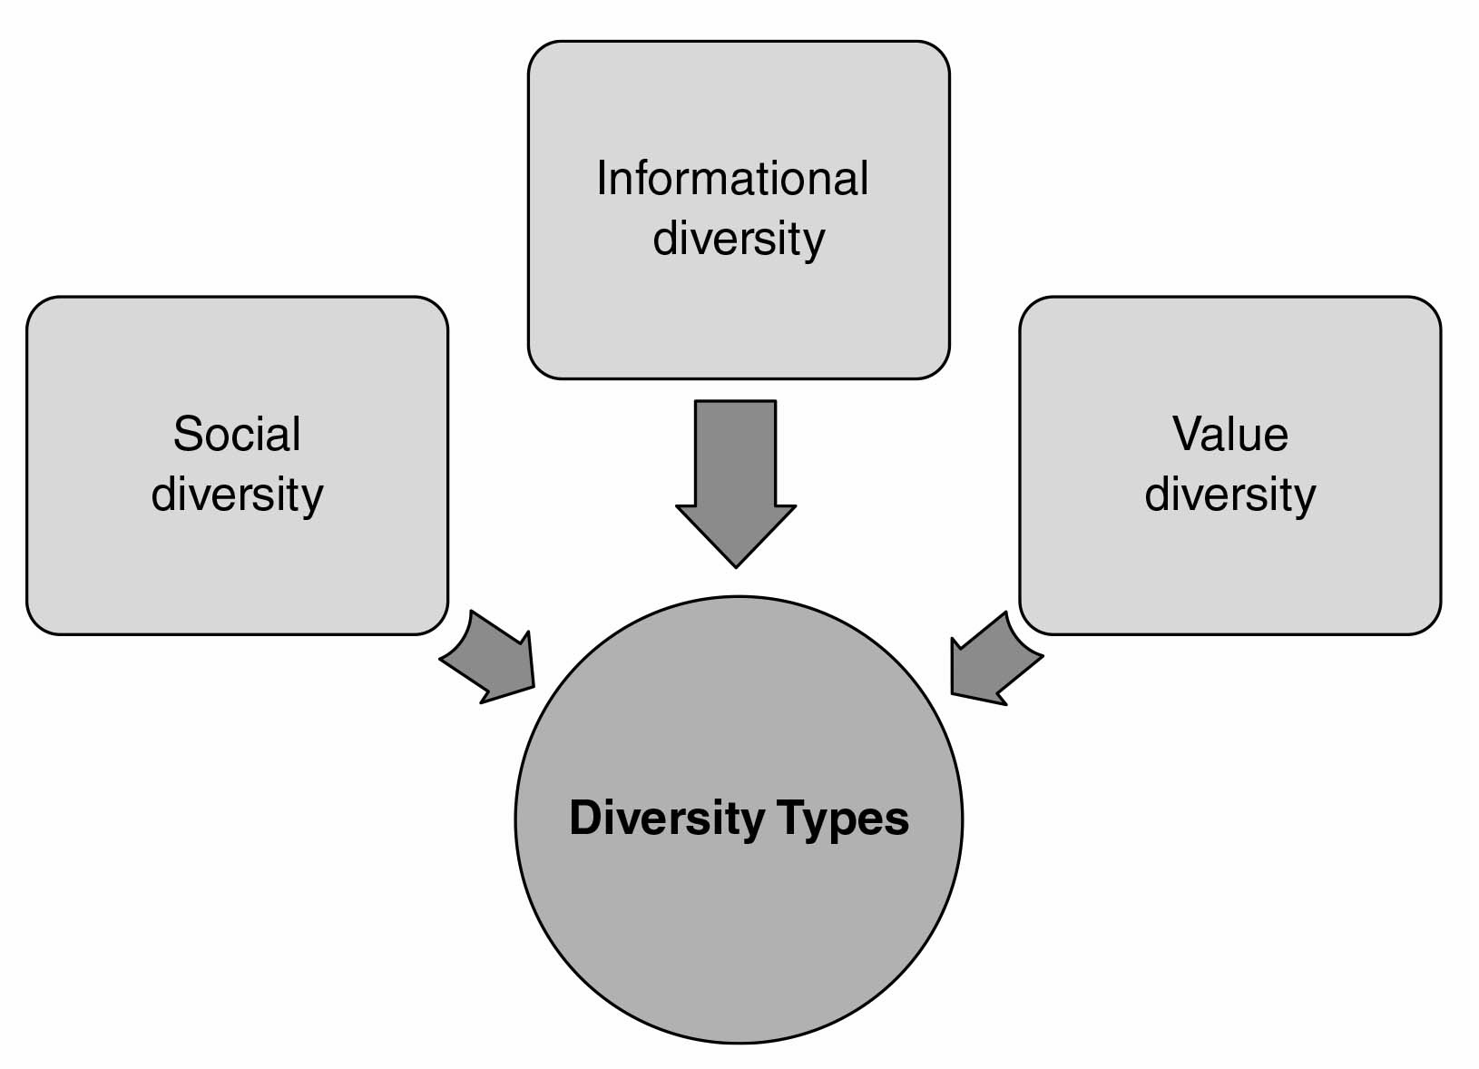
Three diversity types

Slide 12
Maslow’s Hierarchy of Needs
Type of need | Examples
1 Physiological needs | Develop self-satisfaction of hunger, food, shelter and sex
2 Safety and protection | Look for security and stability, feel secure and safe for the future
3 Social (support) | To care for others, love and be loved by others, developing social activities and friendship
4 Self-esteem (respect) | Admiration, self-respect, good opinion
5 Self-actualisation | Developing self-confidence and fulfilling individual potential capabilities

Slide 13
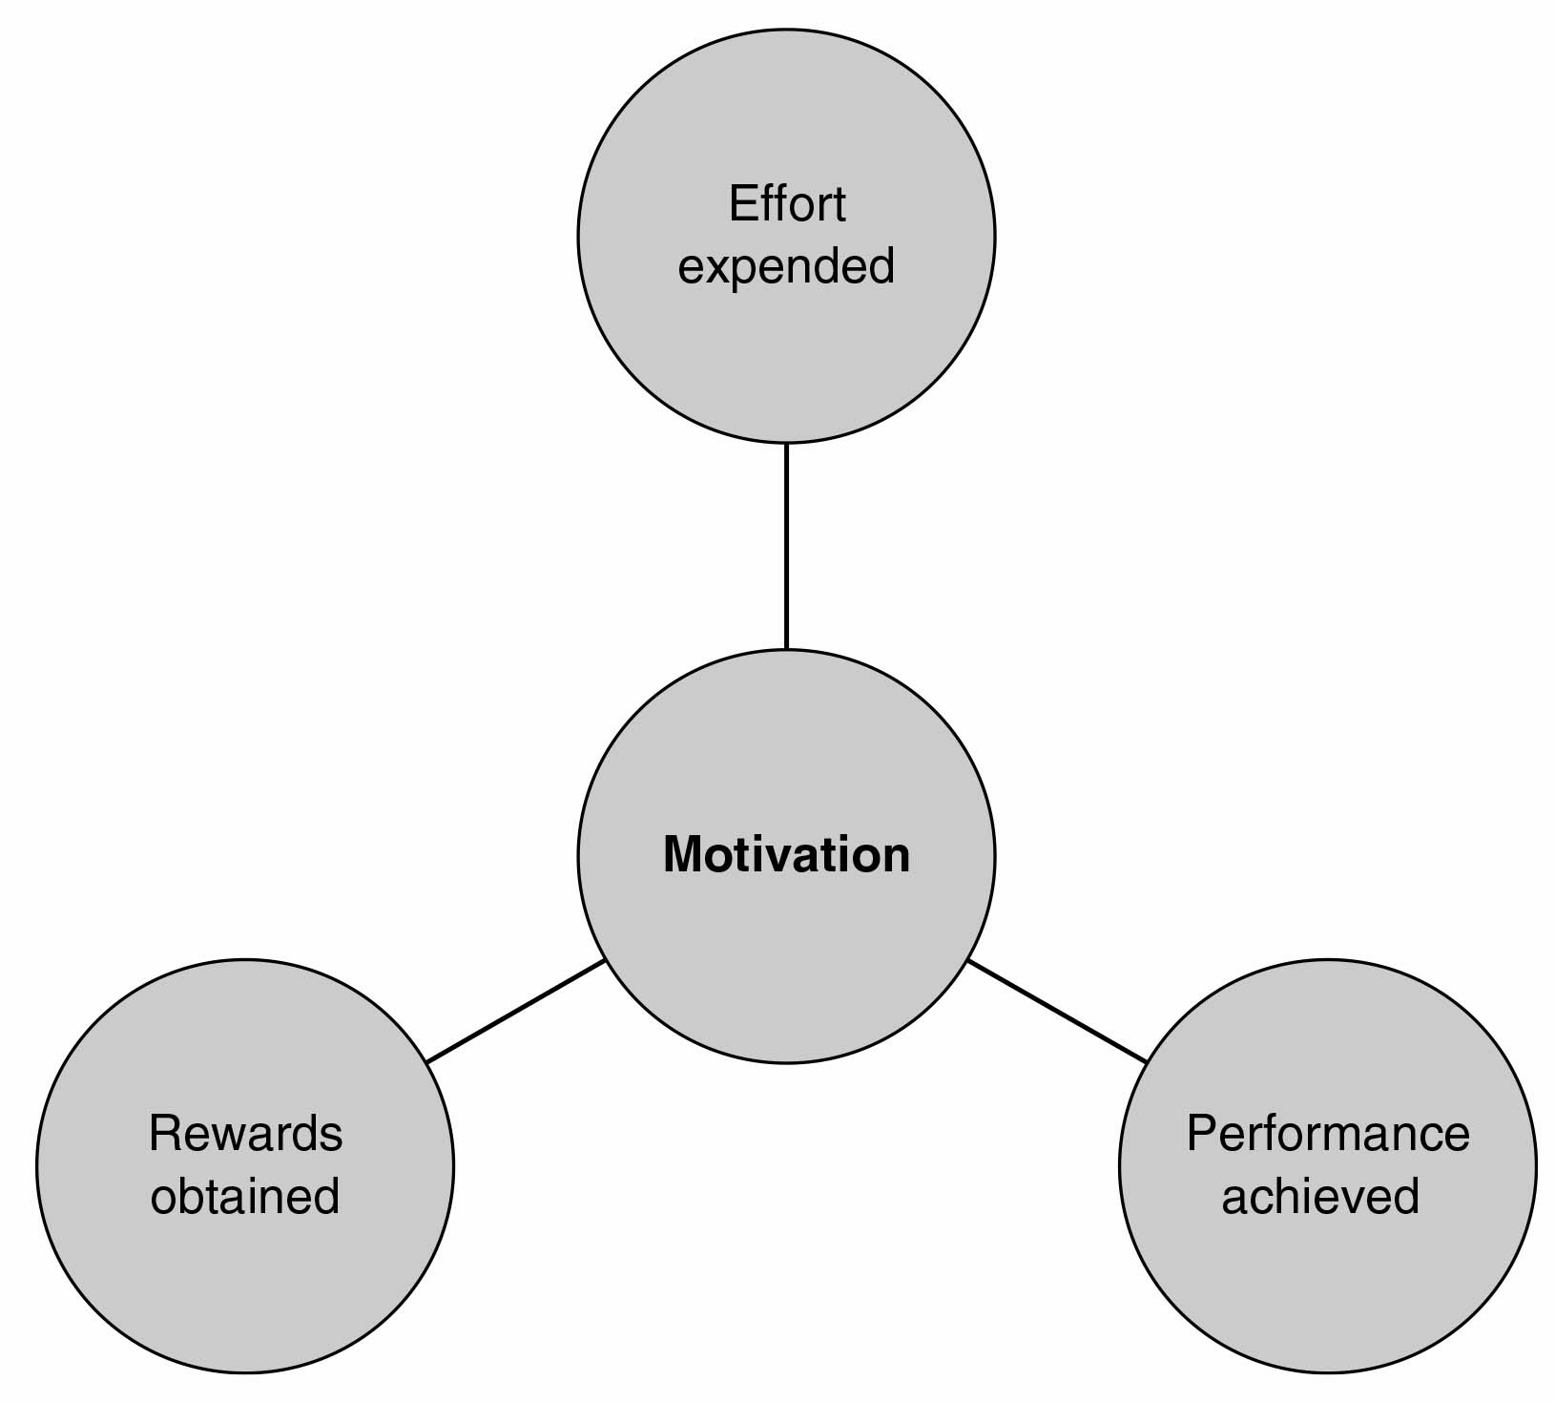
The Expectancy Theory of Motivation

Slide 14
Summary
HRM is a process of staffing and organising the most effective personnel that will benefit the organisation and the event
A process of integrated activities
Empowerment, commitment, diversity and motivation.

Slide 15
Further Reading
Armstrong, M. Taylor, S. (2020) Armstron’s Handbook of Human Resource Management Practice, 15th ed, London: Kogan Page
Fillimonau, V. and Sara Corradini (2019) “Zero-hours contracts and their perceived impact on job motivation of event catering staff”, Event Management, DOI: https://doi.org/10.3727/152599519X15506259855869
Mullins, L.J. (2013) Management and Organisational Behaviour, 10th edn. London: Pearson
Xia, Z. (2017) Human Resource Issues Analysis in Mega Events Industry. European Journal of Research and Reflection in Management Sciences Vol. 5 No. 3, 2017, ISSN 2056-5992

